Slide 1

Support Vector Machines
Prof. Dr. Faisal Shafait
Professor
School of Electrical Engineering and Computer Science (SEECS)
National University of Sciences and Technology (NUST), Islamabad

Slide 2
α
Why Maximum Margin?
X
f
_{y}est
The maximum margin linear classifier is the linear classifier with the, um, maximum margin.
This is the simplest kind of SVM (Called an LSVM)
Support Vectors are those datapoints that the margin pushes up against.
Linear SVM

Slide 3
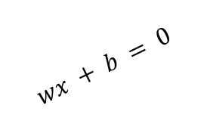
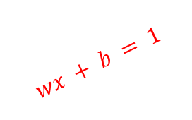
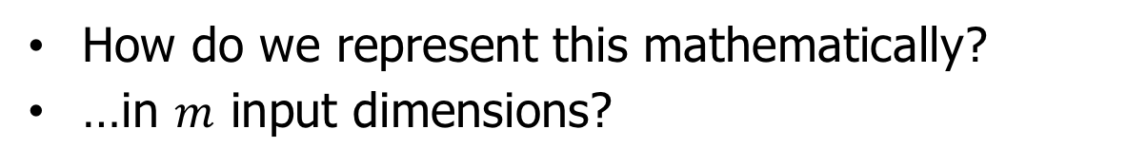
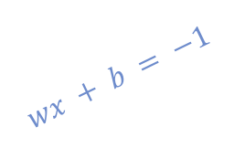
Specifying a line and margin
“Predict Class = +1”
zone
Plus-Plane
Decision Boundary
Minus-Plane
“Predict Class = -1”
zone
$$wx + b = 1$$
$$wx + b = 0$$
$$wx + b = −1$$
How do we represent this mathematically?
…in $m$ input dimensions?

Slide 4
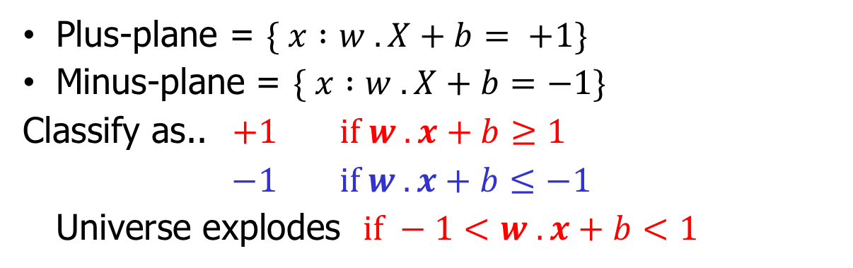
Specifying a line and margin
“Predict Class = +1”
zone
Plus-Plane
Decision Boundary
Minus-Plane
“Predict Class = -1”
zone
$$wx + b = 1$$
$$wx + b = 0$$
$$wx + b = −1$$
Plus-plane = $\{ x :w . X+b= +1\}$
Minus-plane = $\{ x :w . X+b=−1\}$
Classify as.. $+1$ $if w . x+b≥1$
$−1$ $if w . x+b≤−1$
Universe explodes $if −1<w . x+b<1$

Slide 5
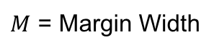
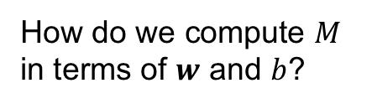
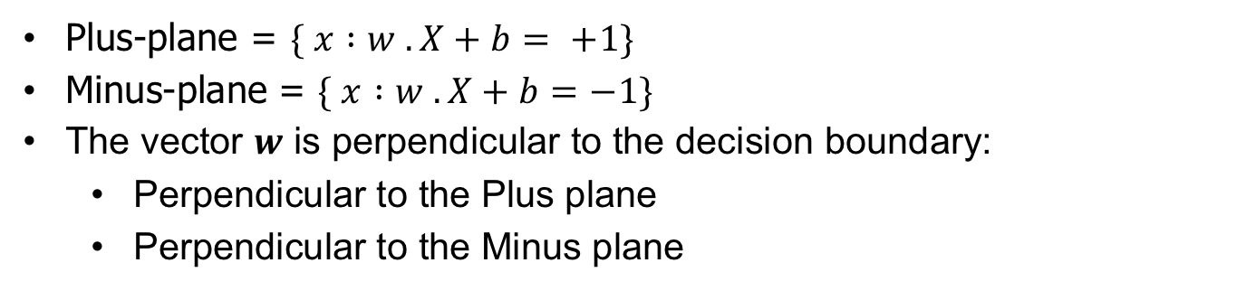
Specifying a line and margin
“Predict Class = +1”
zone
$M$ = Margin Width
“Predict Class = -1”
zone
How do we compute $M$ in terms of $w$ and $b$?
$$wx + b = 1$$
$$wx + b = 0$$
$$wx + b = −1$$
Plus-plane = $\{ x :w . X+b= +1\}$
Minus-plane = $\{ x :w . X+b=−1\}$
The vector $w$ is perpendicular to the decision boundary:
Perpendicular to the Plus plane
Perpendicular to the Minus plane

Slide 6
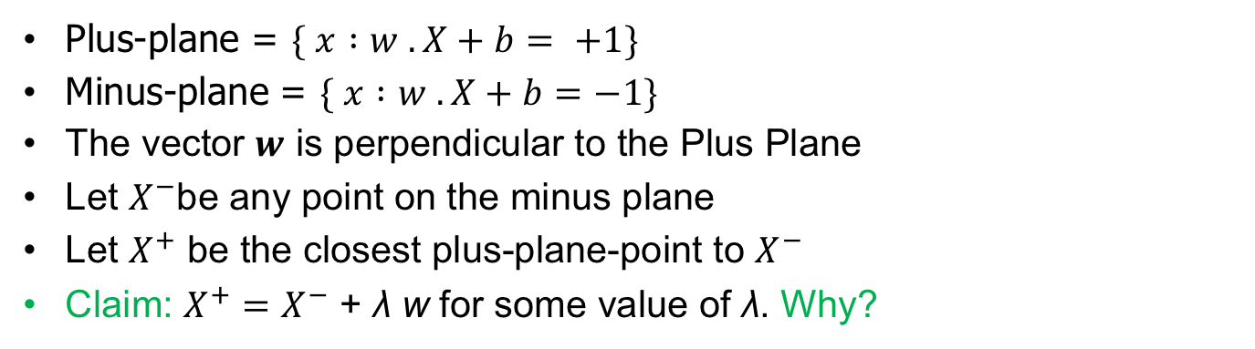
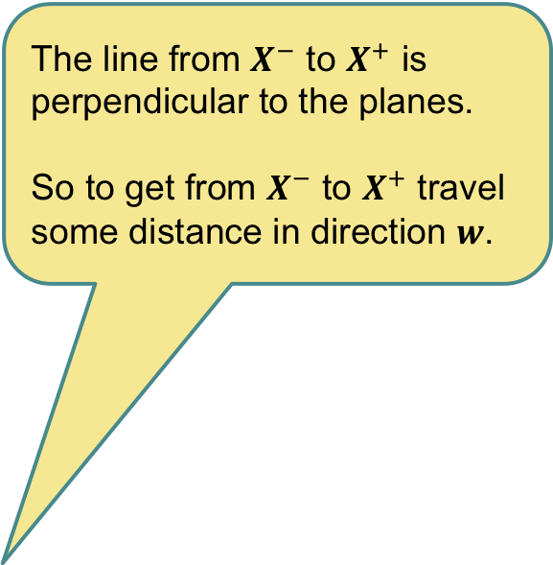
Computing the margin width
“Predict Class = +1”
zone
$M$ = Margin Width
$$X^{+}$$
$$X^{−}$$
The line from $X^{−}$ to $X^{+}$ is perpendicular to the planes.
So to get from $X^{−}$ to $X^{+}$ travel some distance in direction $w$.
“Predict Class = -1”
zone
How do we compute $M$ in terms of $w$ and $b$?
$$wx + b = 1$$
$$wx + b = 0$$
$$wx + b = −1$$
Plus-plane = $\{ x :w . X+b= +1\}$
Minus-plane = $\{ x :w . X+b=−1\}$
The vector $w$ is perpendicular to the Plus Plane
Let $X^{−}$be any point on the minus plane
Let $X^{+}$ be the closest plus-plane-point to $X^{−}$
Claim: $X^{+}$ $=$ $X^{−}$ + λ w for some value of λ. Why?
Any location on the line: not necessarily in datapoints.

Slide 7

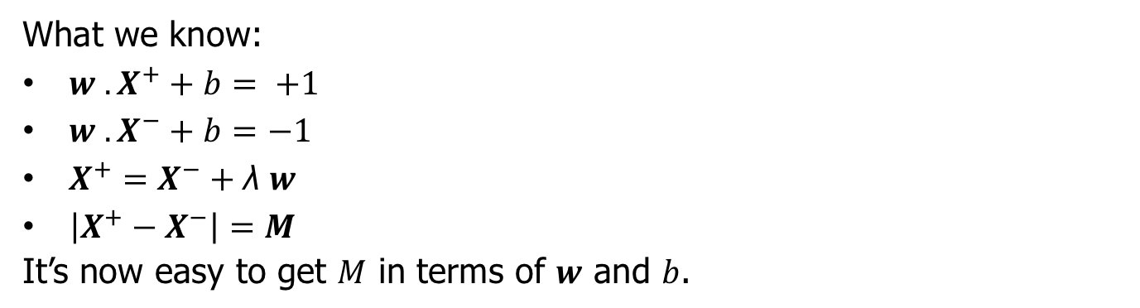
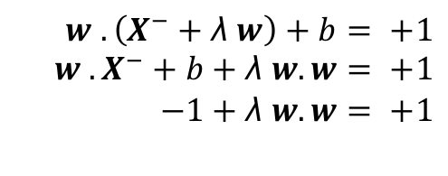
Computing the margin width
“Predict Class = +1”
zone
$M$ = Margin Width
$$X^{+}$$
$$X^{−}$$
“Predict Class = -1”
zone
$$wx + b = 1$$
$$wx + b = 0$$
$$w . \left(X^{−}+\text{λ} w\right)+b= +1$$
$$w . X^{−}+b+\text{λ} w.w= +1$$
$$−1+\text{λ} w.w= +1$$
$$wx + b = −1$$
What we know:
$w . X^{+}+b= +1$
$w . X^{−}+b=−1$
$X^{+}=X^{−}+\text{λ} w$
$\left|X^{+}−X^{−}\right|=M$
It’s now easy to get $M$ in terms of $w$ and $b$.
$$\text{λ}= \frac{2}{w.w}$$

Slide 8
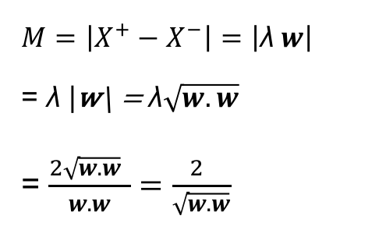
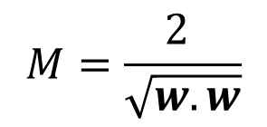
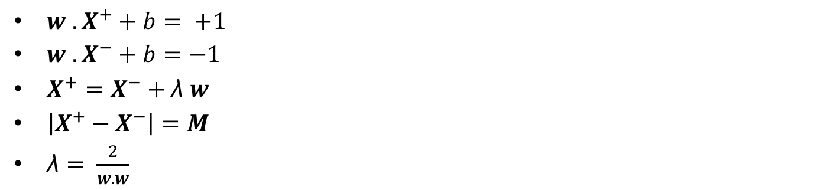
Computing the margin width
“Predict Class = +1”
zone
$M$ = Margin Width
$$M=\frac{2 }{\sqrt{w.w}}$$
$$X^{+}$$
$$X^{−}$$
“Predict Class = -1”
zone
$$wx + b = 1$$
$M=\left|X^{+}−X^{−}\right|=\left|\text{λ} w\right|$
= $\text{λ}\text{ |}\text{w}\text{\backslash = }\text{λ}\sqrt{w.w}$
= $\frac{2\sqrt{w.w} }{w.w}=\frac{2 }{\sqrt{w.w}}$
$$wx + b = 0$$
$$wx + b = −1$$
$w . X^{+}+b= +1$
$w . X^{−}+b=−1$
$X^{+}=X^{−}+\text{λ} w$
$\left|X^{+}−X^{−}\right|=M$
$\text{λ}= \frac{2}{w.w}$

Slide 9
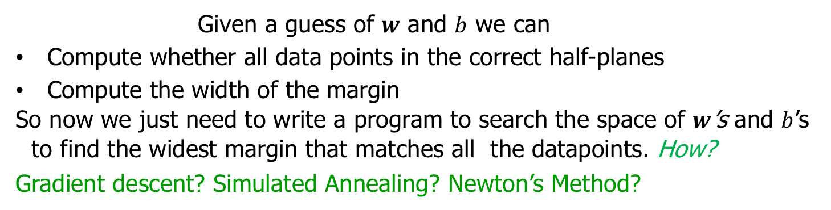
Computing the margin width
“Predict Class = +1”
zone
$M$ = Margin Width
$$M=\frac{2 }{\sqrt{w.w}}$$
$$X^{+}$$
$$X^{−}$$
“Predict Class = -1”
zone
$$wx + b = 1$$
$$wx + b = 0$$
$$wx + b = −1$$
Given a guess of $w$ and $b$ we can
Compute whether all data points in the correct half-planes
Compute the width of the margin
So now we just need to write a program to search the space of $w$’s and $b$’s to find the widest margin that matches all the datapoints. How?
Gradient descent? Simulated Annealing? Newton’s Method?

Slide 10

Optimization Revisited

Slide 11
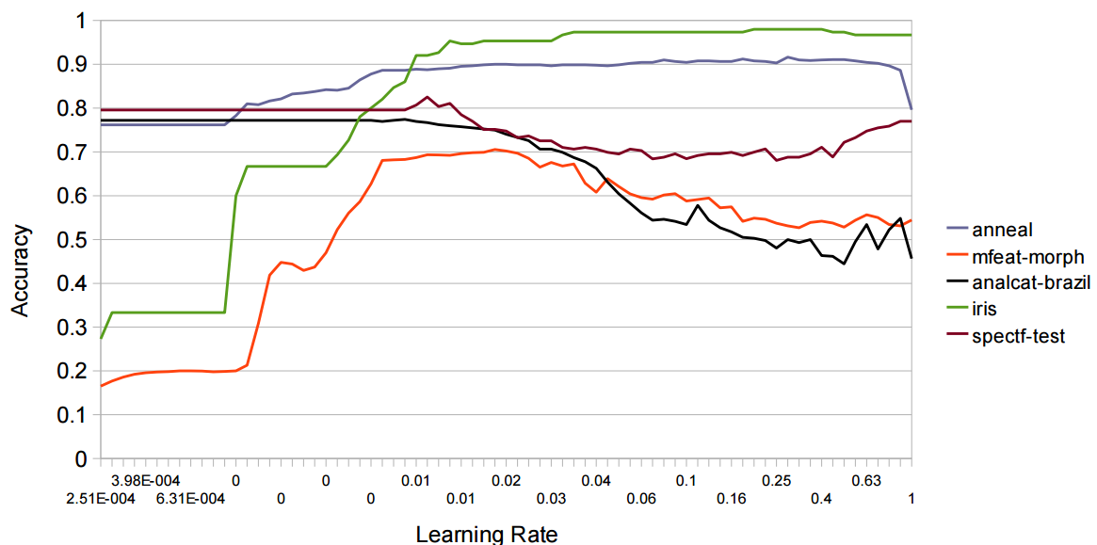
Example: Neural Network Training
Results of learning rate optimization on 5 different datasets from UCI repository
The neural network was trained 100 times on each dataset, by changing the value of the learning rate from 0.0001 to 1 in 100 steps on a logarithmic scale.

Slide 12
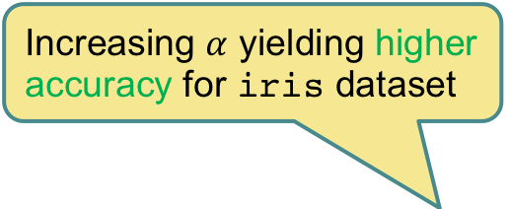
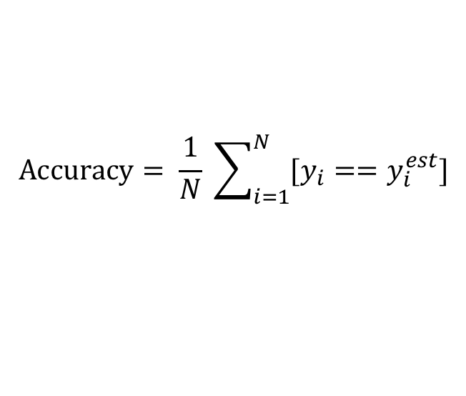
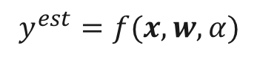
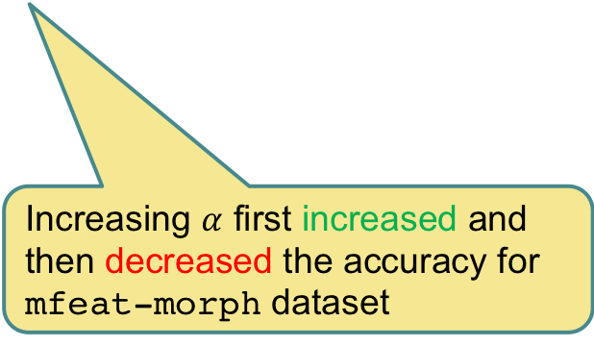
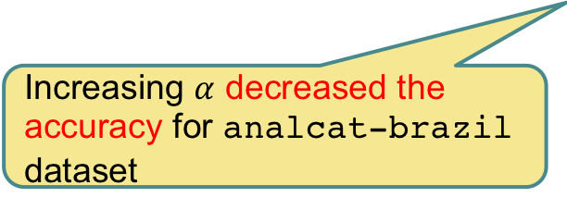
Objective Function
$$Accuracy= \frac{1}{N} \sum_{i=1}^{N}{[y_{i}==y_{i}^{est}]}$$
$$y^{est}=f(x,w,α)$$
Increasing $α$ yielding higher accuracy for iris dataset
Increasing $α$ decreased the accuracy for analcat-brazil dataset
Increasing $α$ first increased and then decreased the accuracy for mfeat-morph dataset

Slide 13
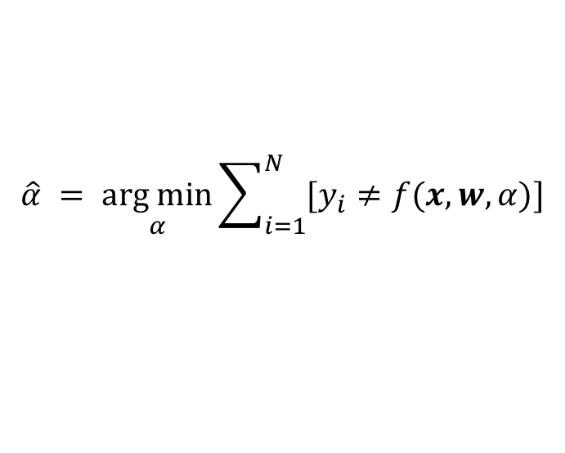
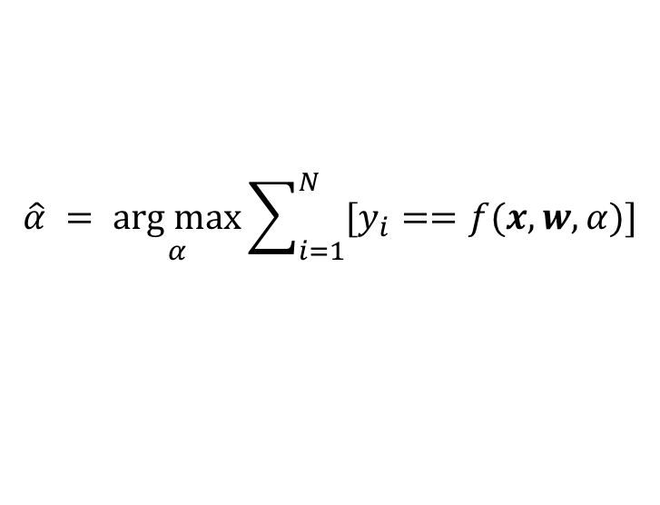
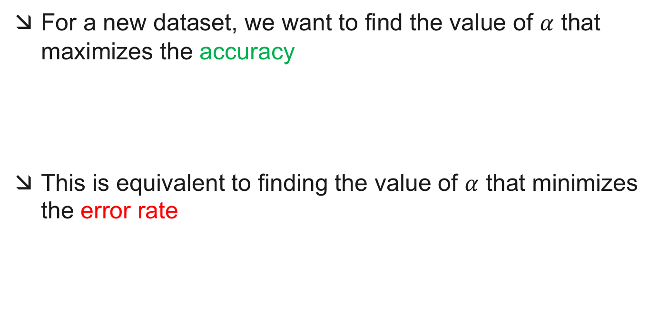
Maximizing / Minimizing the Objective Function
For a new dataset, we want to find the value of $α$ that maximizes the accuracy
This is equivalent to finding the value of $α$ that minimizes the error rate
$$\hat{α} = \underset{α}{arg max}{\sum_{i=1}^{N}{[y_{i}==f(x,w,α)]}}$$
$$\hat{α} = \underset{α}{arg min}{\sum_{i=1}^{N}{[y_{i}≠f(x,w,α)]}}$$

Slide 14
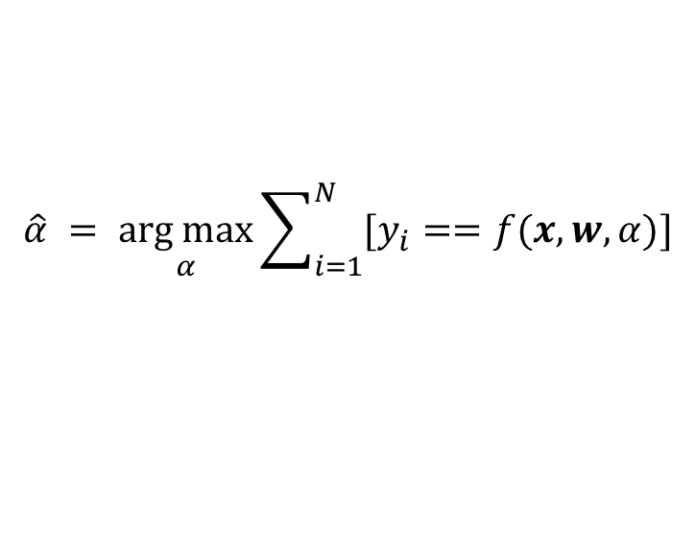
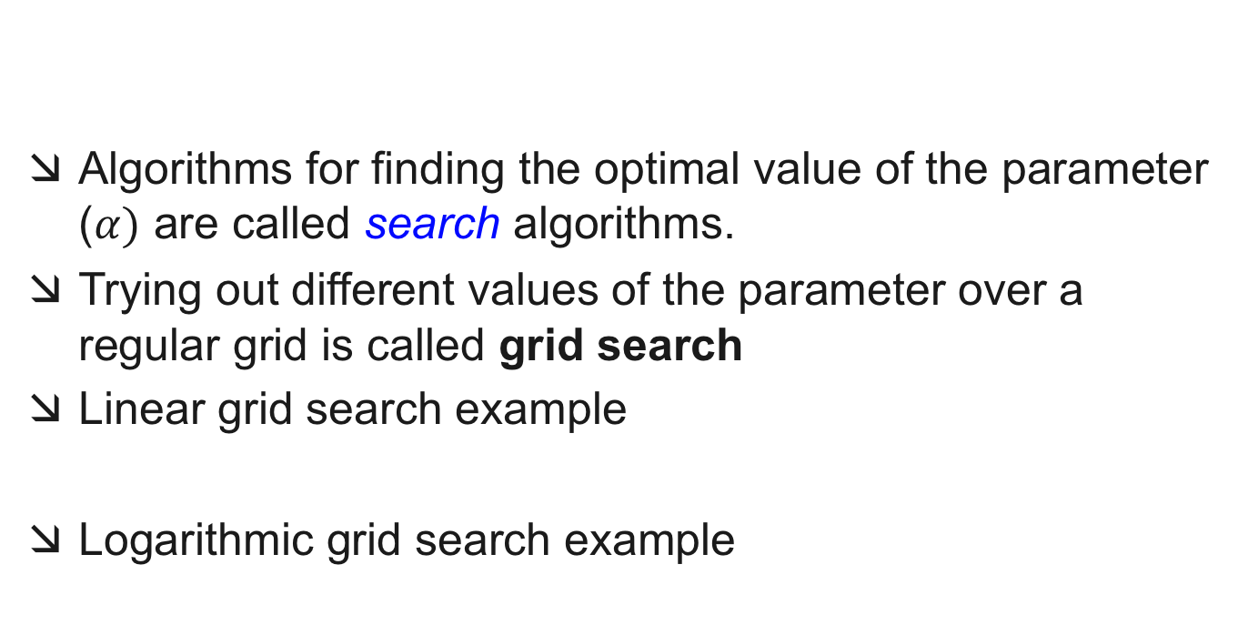
Grid Search
Algorithms for finding the optimal value of the parameter ($α)$ are called search algorithms.
Trying out different values of the parameter over a regular grid is called grid search
Linear grid search example
Logarithmic grid search example
$$\hat{α} = \underset{α}{arg max}{\sum_{i=1}^{N}{[y_{i}==f(x,w,α)]}}$$
$$α=\{0.1, 0.2, 0.3, 0.4, 0.5, 0.6, 0.7, 0.8, 0.9, 1.0\}$$
$$α=\{0.00001, 0.0001, 0.001, 0.01, 0.1, 1.0\}$$

Slide 15
Gradient Descent
Practical challenges of grid search
Very slow
Computationally expensive
How to decide the grid size?
How to decide the grid resolution?
Gradient descent is a good practical alternative
May get stuck in a local minima / maxima
Works very well if the objective function is convex

Slide 16
Gradient Descent
Will find global maxima for this hypothetical dataset, since the objective function is convex
Likely to get stuck at this local maxima for mfeat-morph dataset

Slide 17
Computing the margin width
“Predict Class = +1”
zone
$M$ = Margin Width
$$M=\frac{2 }{\sqrt{w.w}}$$
$$X^{+}$$
$$X^{−}$$
“Predict Class = -1”
zone
$$wx + b = 1$$
$$wx + b = 0$$
$$wx + b = −1$$
Given a guess of $w$ and $b$ we can
Compute whether all data points in the correct half-planes
Compute the width of the margin
So now we just need to write a program to search the space of $w$’s and $b$’s to find the widest margin that matches all the datapoints. How?
Gradient descent? Simulated Annealing? Newton’s Method?

Slide 18
Margin Maximization Problem
Finding maximum margin in linearly separable case
The objective function is differentiable and convex
A globally optimal solution can be computed in O(n³)
SVMs in practice: computational effort ≈ O(n^{1.8})

Slide 19
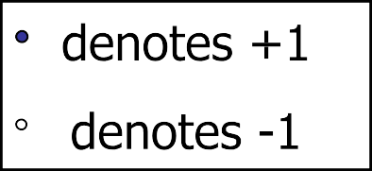
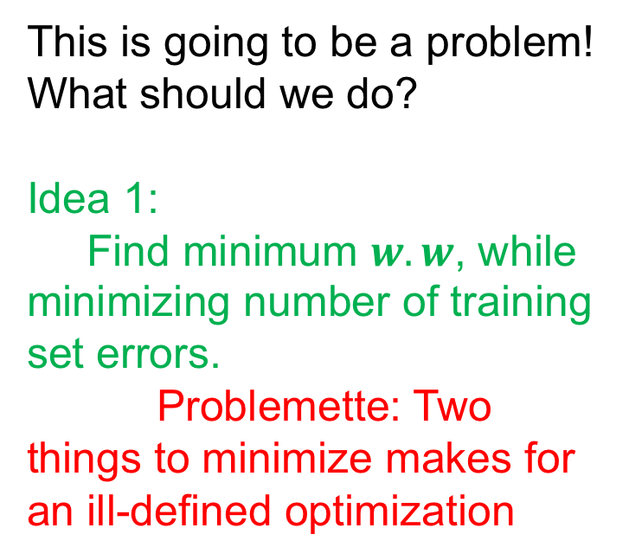
Uh ho!
This is going to be a problem!
What should we do?
Idea 1:
Find minimum $w.w$, while minimizing number of training set errors.
Problemette: Two things to minimize makes for an ill-defined optimization

Slide 20
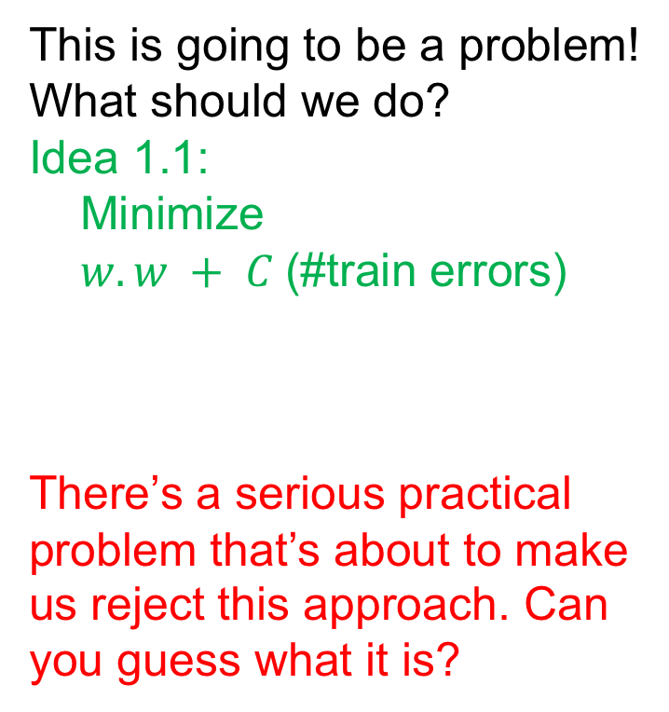
Uh ho!
This is going to be a problem!
What should we do?
Idea 1.1:
Minimize
$w.w + C$(#train errors)
There’s a serious practical problem that’s about to make us reject this approach. Can you guess what it is?
So… any other ideas?
Trade off parameter.
Can’t be expressed as a convex optimization problem since it is not differentiable.
Solving it may be too slow.
(Also, doesn’t distinguish between disastrous errors and near misses)

Slide 21
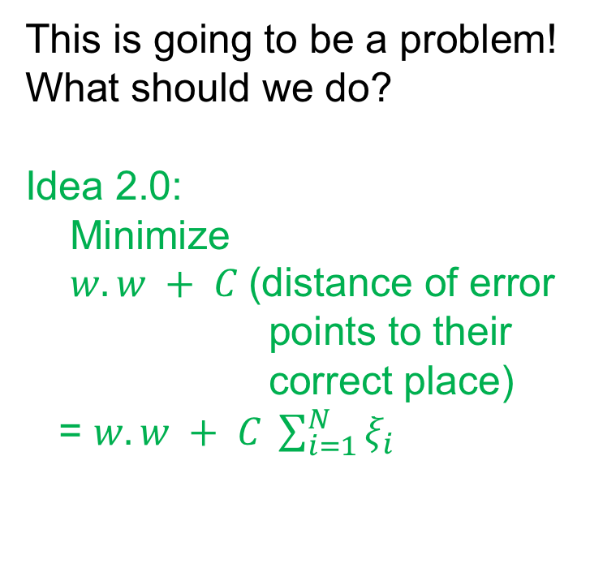
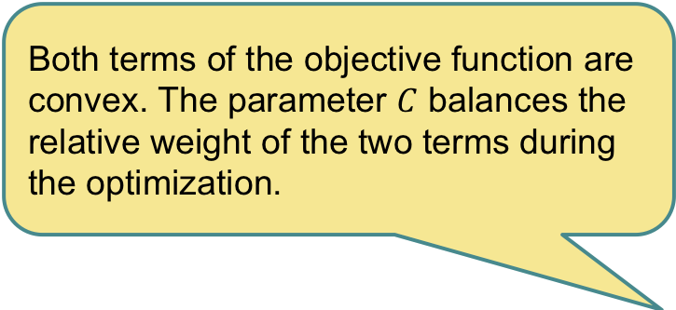
Uh ho!
This is going to be a problem!
What should we do?
Idea 2.0:
Minimize
$w.w + C$(distance of error points to their correct place)
= $w.w + C \sum_{i=1}^{N}{ξ_{i}}$
Both terms of the objective function are convex. The parameter $C$ balances the relative weight of the two terms during the optimization.

Slide 22
Computing Classifier Confidence
SVM is a discriminant function; it gives you the class but not the posterior probability
How can we know the confidence of the classification?
Distance of the data point from the decision boundary
Why do we need the confidence?

Slide 23
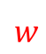
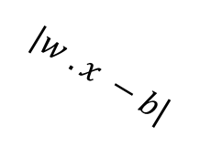
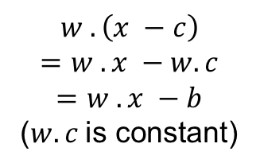
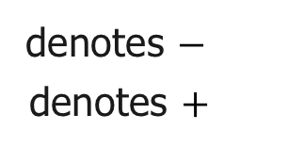
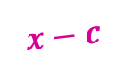
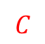

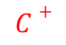
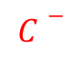
Computing Classifier Confidence
$$C−$$
$$w$$
$$x$$
$$w . \left(x −c\right)$$
$$=w . x −w. c$$
$$=w . x −b$$
($w.c$is constant)
$$x−c$$
$$C$$
$|w . x −b$|
$$C+$$
denotes $−$
denotes $+$

Slide 24
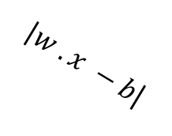
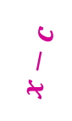

Computing Classifier Confidence
$$C−$$
$$w$$
$$w . \left(x −c\right)$$
$$=w . x −w. c$$
$$=w . x −b$$
($w.c$is constant)
$$C$$
$|w . x −b$|
$$C+$$
$$x−c$$
$$x$$
denotes $−$
denotes $+$

Slide 25
Multi-Class SVM

Slide 26
Binary to Multi-Class
Most schemes for multiclass classification work by reducing the problem to that of binary classification.
There are multiple ways to decompose the multiclass prediction into multiple binary decisions
One-vs-All
All-vs-All

Slide 27
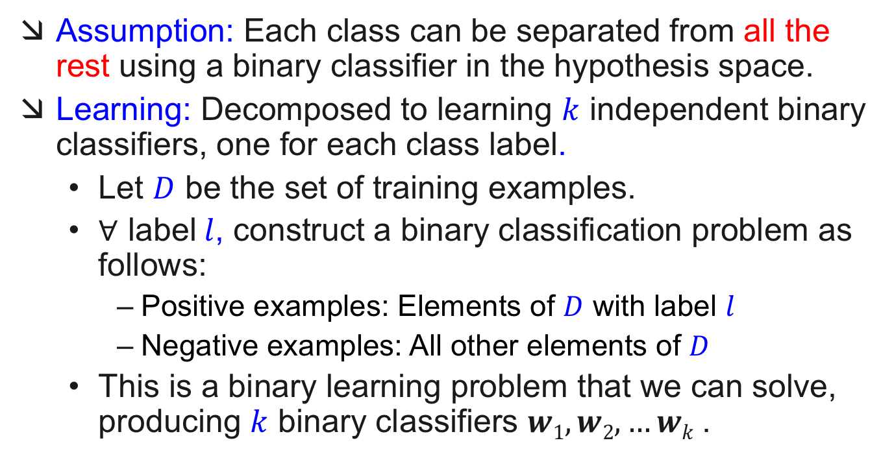
One-vs-All
Assumption: Each class can be separated from all the rest using a binary classifier in the hypothesis space.
Learning: Decomposed to learning $k$ independent binary classifiers, one for each class label.
Let $D$ be the set of training examples.
$∀$ label$l$, construct a binary classification problem as follows:
Positive examples: Elements of $D$ with label $l$
Negative examples: All other elements of $D$
This is a binary learning problem that we can solve, producing $k$ binary classifiers $w1, w2, …wk$.

Slide 28
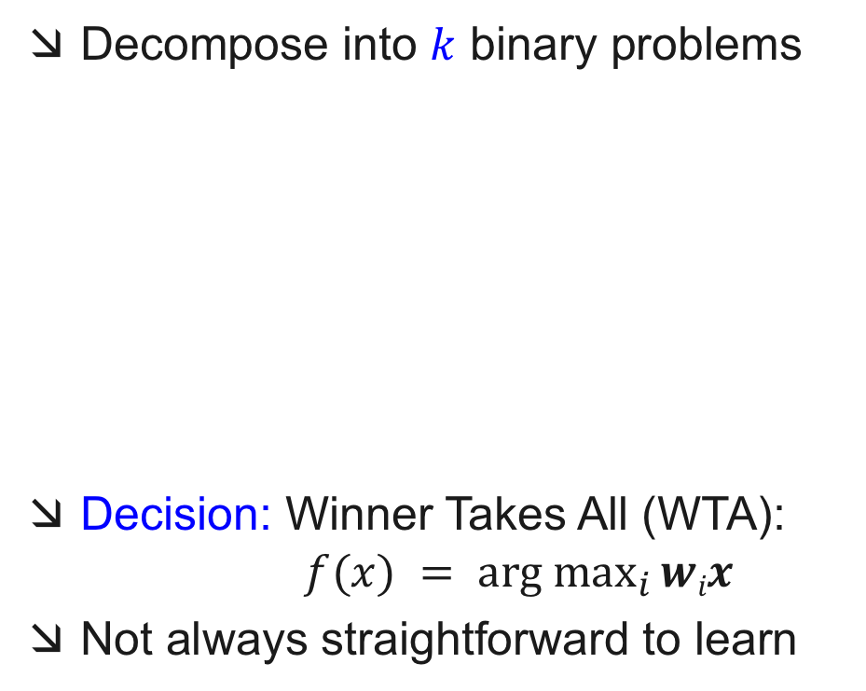
Solving MultiClass with One-vs-All learning
Decompose into $k$ binary problems
Decision: Winner Takes All (WTA): $f(x) = \underset{i}{arg max}{wix}$
Not always straightforward to learn

Slide 29
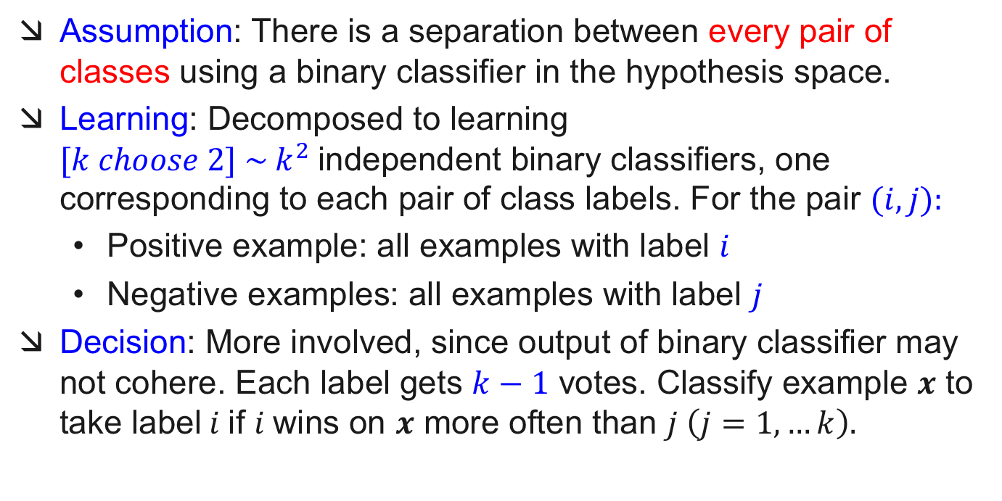
All-vs-All
Assumption: There is a separation between every pair of classes using a binary classifier in the hypothesis space.
Learning: Decomposed to learning $[k choose 2] \sim k^{2}$independent binary classifiers, one corresponding to each pair of class labels. For the pair $(i, j):$
Positive example: all examples with label $i$
Negative examples: all examples with label $j$
Decision: More involved, since output of binary classifier may not cohere. Each label gets $k−1$ votes. Classify example $x$ to take label$i$if $i$wins on $x$ more often than $j \left(j=1,…k\right).$

Slide 30
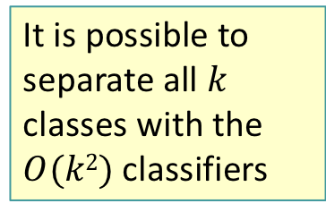
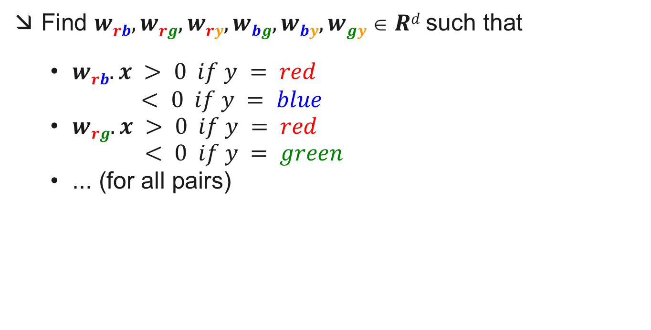
Solving MultiClass with All-vs-All learning
Find $wrb,wrg,wry,wbg,wby,wgy  Rd$such that
$wrb.x > 0 if y = red$
$< 0 if y = blue$
$wrg.x > 0 if y = red$
$< 0 if y = green$
... (for all pairs)
It is possible to separate all $k$ classes with the $O(k2)$classifiers
Individual
Classifiers
Decision
Regions
Notes:
[ GENERAL NOTE: Focus on diagram, say it’s more powerful than WTA]
AvA (All versus all)
expand representation space
learn (k choose 2) classifiers
separate each pair of classes
for example Vred,green separates all red points from greed points
Decision Surface
Can cover any example set the WTA can generate
BUT
1. TOO COMPLEX
2. AMBIGUOUS – Black regions are unknown
tournament or majority vote necessary

Slide 31
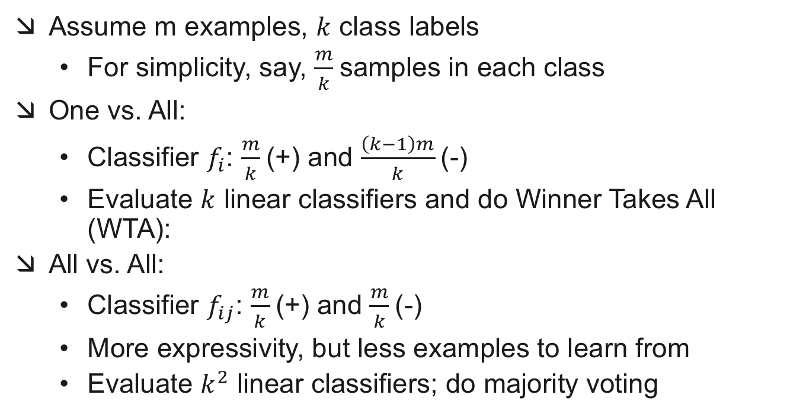
One-vs-All vs. All-vs-All
Assume m examples, $k$ class labels
For simplicity, say, $\frac{m}{k}$samples in each class
One vs. All:
Classifier $f_{i}$: $\frac{m}{k}$(+) and $\frac{\left(k−1\right)m}{k}$(-)
Evaluate $k$ linear classifiers and do Winner Takes All (WTA):
All vs. All:
Classifier $f_{ij}$: $\frac{m}{k}$(+) and $\frac{m}{k}$(-)
More expressivity, but less examples to learn from
Evaluate $k^{2}$ linear classifiers; do majority voting

